Slide 1

Deep Learning Overview & Core Concepts
汇报人
时间:2025.01.01

Slide 2

目录
CONTENTS
01
Definition and Evolution of Deep Learning
02
Core knowledge of deep learning
03
Applications of Deep Learning

Slide 3


01
Definition and Evolution
of Deep Learning

Slide 4

Definition and Evolution
Historical Context
Deep learning originates from the research of artificial neural networks, and its development has experienced multiple ups and downs.
From the early perceptrons to the modern complex network architectures, every technological breakthrough has laid the foundation for the advancement of artificial intelligence.
By simulating the working mode of human brain neurons, deep learning can automatically learn complex patterns in data, so as to achieve prediction and classification of unknown data.
This has enabled it to achieve revolutionary results in fields such as image recognition and natural language processing.

Slide 5
Definition and Evolution
Modern Impact
In today's digital era, deep learning is profoundly transforming the way we live and work.
It not only drives the development of cutting-edge technologies such as autonomous driving and intelligent voice assistants, but also plays a crucial role in traditional fields like medical image diagnosis and financial risk prediction.
The efficiency and accuracy of deep learning models have made them a powerful tool for solving complex problems, providing strong momentum for the intelligent transformation of various industries and leading a new wave of artificial intelligence.

Slide 6
02
Core knowledge of deep learning

Slide 7
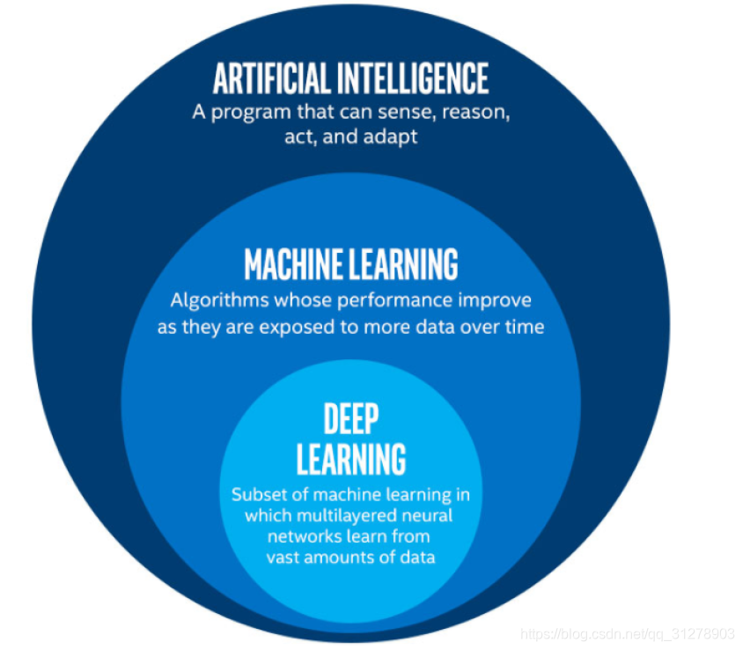
An intuitive understanding of deep learning
Deep Learning (DL) addresses the fundamental bottleneck of manual feature engineering in traditional Machine Learning (ML) by enabling automatic, hierarchical feature learning directly from raw data.

Slide 8
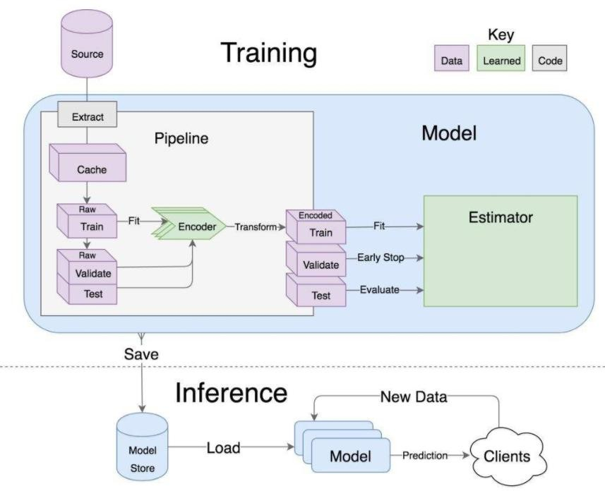
Get a quick overview of the machine learning process
Machine learning processes
Data acquisition
Feature engineering
Build a model
Evaluation & Application

Slide 9
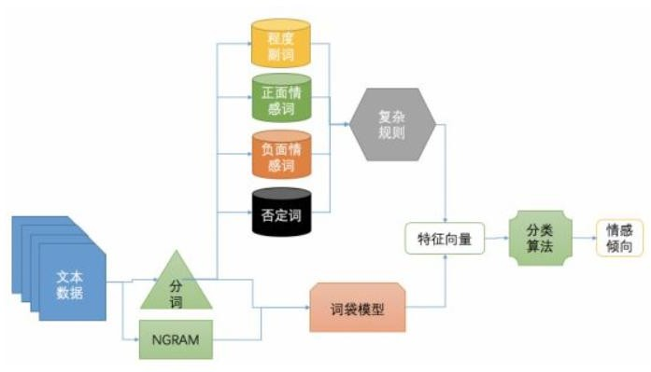
Get a quick overview of the machine learning process
The role of feature engineering:
The data characteristics determine the upper bound of the model
Preprocessing and feature extraction are the core
The algorithm and parameter selection determine how to approximate this upper limit

Slide 10
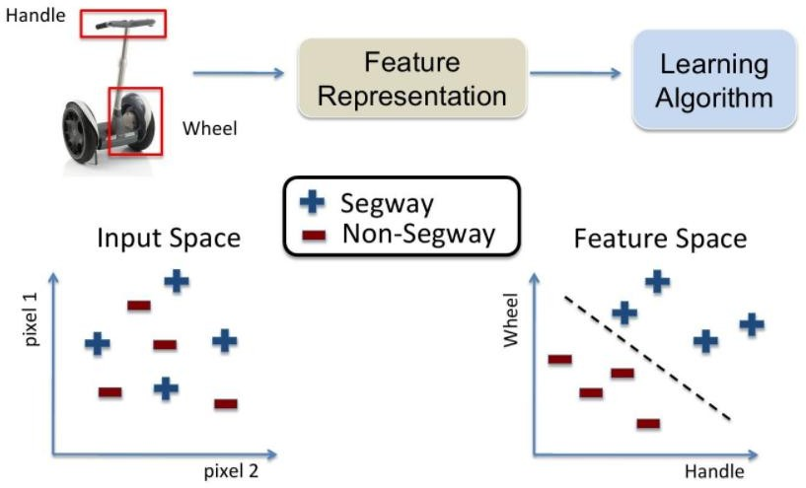
Get a quick overview of the machine learning process
Why feature extraction matters:
Raw data (pixel) hides patterns; extracted semantic features reveal discriminative structures.
Feature extraction maps chaotic raw data to a structured space where classes become separable.

Slide 11
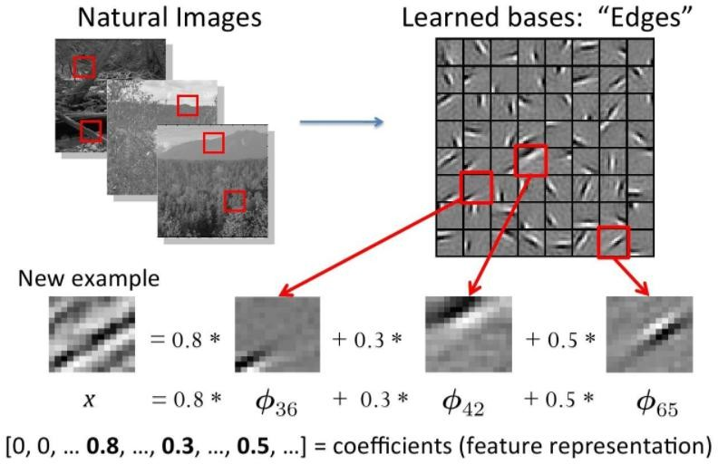
Get a quick overview of the machine learning process
Traditional Feature Extraction Methods:
Traditional Machine Learning: Manual Feature Design.
Experts create features based on domain knowledge (e.g., extracting edges/textures in images; calculating word frequency in text).
Typical methods: SIFT (images), HOG (object detection), TF-IDF (text).
Traditional methods rely on domain expertise—time-consuming and limited;

Slide 12
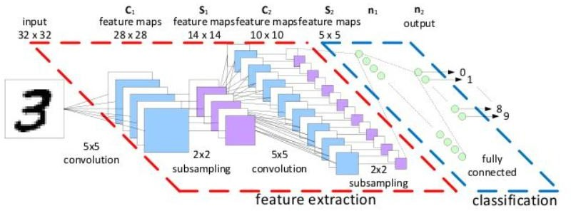
Why do you need deep learning?
Deep Learning: Feature Extraction Methods:
Deep Learning: Automatic Feature Learning
Neural networks hierarchically learn features directly from raw data
Shallow layers: Basic features (e.g., edges, textures)
Middle layers: Composite features (e.g., object parts)
Deep layers: Abstract features (e.g., holistic objects, semantics)
Requires no manual intervention; optimized end-to-end.
Deep learning automatically extracts complex, task-adaptive features through hierarchical abstraction.

Slide 13
Why do you need deep learning?
The fundamental shift from ML to DL is the automation of feature extraction. Traditional ML hits a wall with complex raw data and tasks due to the limitations of manual feature engineering.
Deep Learning breaks through this wall by enabling models to learn increasingly complex and abstract features directly from the data itself, in a hierarchical manner.
This automation and representational power make DL essential for tackling modern AI challenges in vision, speech, language, and beyond, where raw data complexity defies manual feature design.

Slide 14
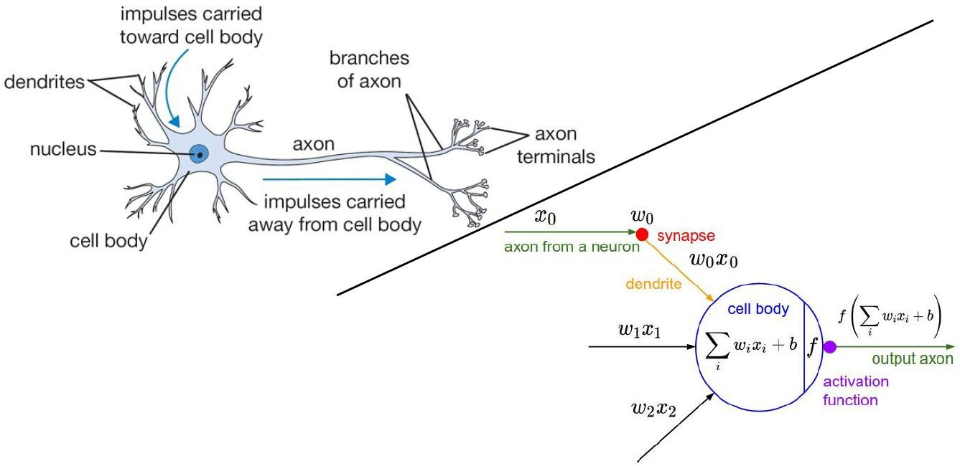
By simulating the working mechanism of human brain neurons, deep learning can automatically learn complex patterns from data, thus enabling the prediction and classification of unknown data.
An intuitive understanding of deep learning

Slide 15
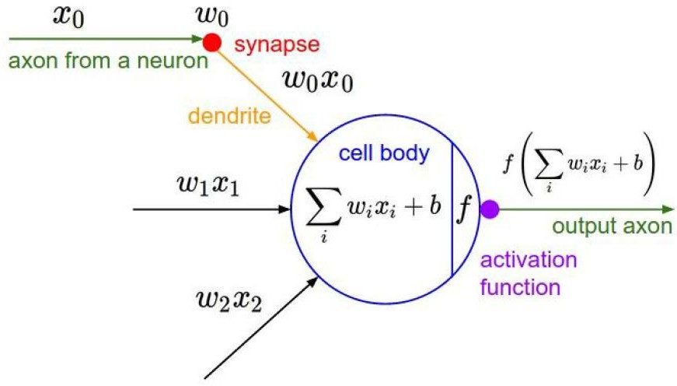
an artificial neuron (perceptron) in deep learning mimics a biological neuron
An intuitive understanding of deep learning
Inputs (x0, x1, x2...):
Like signals entering a biological neuron's dendrites.
These are the raw data values fed into the artificial neuron.
Weights (w0, w1, w2...):
Like the strength of biological synapses.
Each input (x) has a weight (w). Weights determine the importance of each input. They are learned during training.

Slide 16
an artificial neuron (perceptron) in deep learning mimics a biological neuron
An intuitive understanding of deep learning
Weighted Sum + Bias (∑i w_{i} x_{i} + b):
Like signal integration in the biological cell body.
The neuron calculates: Multiply each input by its weight (w_{i} * x_{i}), sum all these products (∑), then add a bias term (b). Bias adjusts how easily the neuron activates.

Slide 17
an artificial neuron (perceptron) in deep learning mimics a biological neuron
An intuitive understanding of deep learning
Activation Function (f):
Like the biological neuron's decision to "fire" an output signal down its axon.
This non-linear function (e.g., Sigmoid, ReLU) transforms the weighted sum (∑i w_{i} x_{i} + b). It decides if and how strongly the artificial neuron activates (produces an output).

Slide 18
an artificial neuron (perceptron) in deep learning mimics a biological neuron
An intuitive understanding of deep learning
Output (output axon):
Like the signal sent out via the biological axon.
The result of the activation function (f(∑_{i} w_{i}x_{i} + b)) becomes this neuron's output. This output can be sent to other neurons in the network.
This is NOT a real biological neuron!

Slide 19
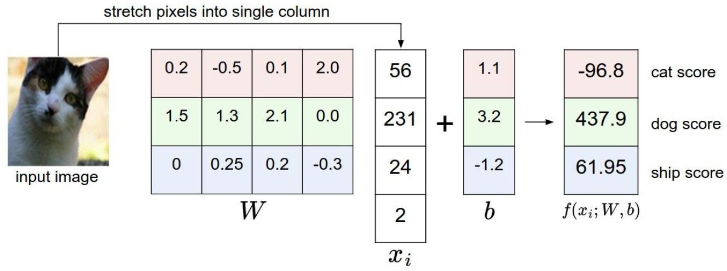
We've learned how neurons are calculated, so let's take a simple example
A simple example
​​Input Image​​:Starting with an input image of a ​​cat​​ (leftmost element).
2. ​​Image Representation (W)：The image pixels are flattened into a ​​3×4 matrix W​​, converting visual data into numerical values the model can process.

Slide 20
We've learned how neurons are calculated, so let's take a simple example
A simple example
3. ​​W is multiplied by a ​​weight vector x_{i​ ​​} (4×1 matrix, e.g., [56,231,24,2] ), followed by adding a ​​bias vector b​​ (e.g., [1.1,3.2,−1.2,0] ).
Equation: Output=W*x _{i}+b
This step extracts meaningful features by emphasizing important patterns (guided by x_{i} ) and adjusting
baselines (via b).

Slide 21
We've learned how neurons are calculated, so let's take a simple example
A simple example
4. ​​​​Activation & Class Scores​​:The transformed values pass through a function f(x
;W,b) (e.g., ReLU or linear activation) to generate ​​class scores​​:
​​Cat: -96.8​​
​​Dog: 437.9​​
​​Ship: 61.95​
Scores represent the
model’s confidence for each
class. Higher values indicate
stronger predictions.

Slide 22
Key Insights​​:
A simple example
Why the cat image got a high dog score?​​
The model’s parameters (x_{i}and b) are not yet optimized. During training, these values adjust to minimize errors (e.g., ensuring cat images yield the highest cat score).
​​Purpose​​:
This ​​forward pass​​ demonstrates how raw pixels translate to class predictions. Real-world models stack multiple such layers for complex tasks.

Slide 23
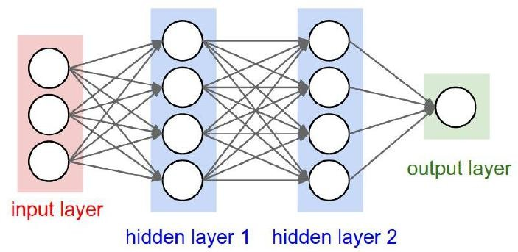
An intuitive understanding of deep learning
Overall Architecture
Hierarchical Structure
Neuron
Fully Connected
Nonlinearity
The neuron structure explained above is the level of deep learning, the most basic operating unit

Slide 24
Now let's take convolutional neural networks(ccn) as an example to explain the hierarchy of deep learning.
Hidden layers
Convolutional layers
Activating the Layer
Fully connected layer
Pooling layer
Output layer
Input layer

Slide 25
Now let's take convolutional neural networks(ccn) as an example to explain the hierarchy of deep learning.
Diagram Explanation:
1. Input Image
Raw pixel data enters the network (e.g., 224×224 RGB image)
2. Hidden Layers (Core Processing Unit)
Where feature extraction and transformation occur
Contains three fundamental operations:
Convolution Layer:
Slides learnable filters across input to detect local patterns (edges, textures)
Activation Layer (ReLU):
Applies non-linear transformation (negative values → 0, positives unchanged)
Pooling Layer:
Downsamples features (e.g., 2×2 max pooling) to reduce dimensionality while
retaining key information

Slide 26
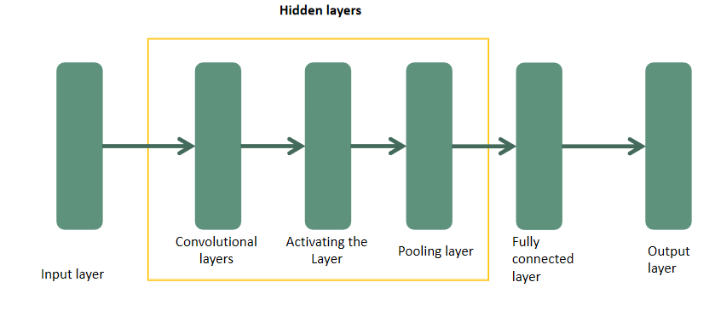
Now let's take convolutional neural networks(ccn) as an example to explain the hierarchy of deep learning.
3. Fully Connected Layer
Integrates high-level features from all spatial locations
Learns global relationships between extracted features
4. Output Layer
Produces final predictions (e.g., Softmax for classification probabilities)

Slide 27
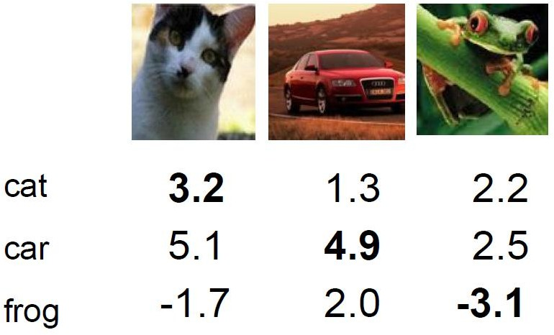
loss function
In the above learning, we have already understood how deep learning works and how to calculate scores for each category
How to measure the results of
classification?-----loss function
There is a significant difference in the score values of the results, and we need clear guidance on how good or bad the current performance of the model is!

Slide 28
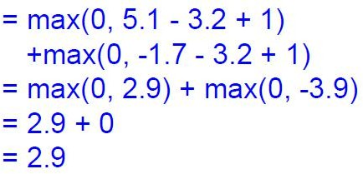
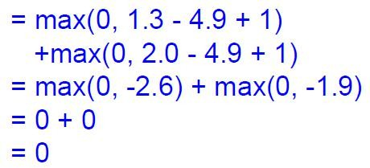
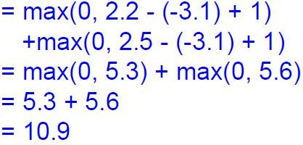
loss function
loss function
cat loss
There are actually many types of loss functions, let's experiment with one
car loss
frog loss
The higher the loss, the less accurate the classification

Slide 29
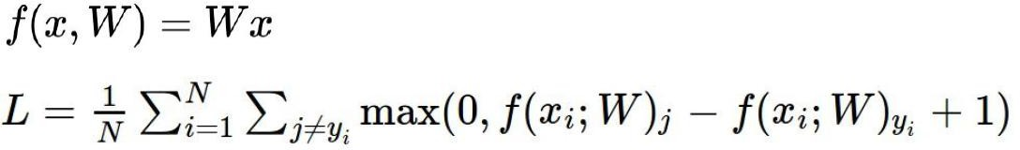
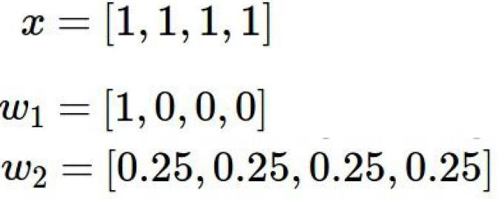

loss function
To prevent overfitting of the model, we can add a regularization penalty term to the loss function
输入数据：
模型A：模型B：
The values of these two loss functions are the same, but the two models are different

Slide 30

loss function
How does it mean that two models are the same when the value of the loss function is the same?
regularization penalty term
Loss function=data loss+regularization penalty term
regularization penalty term:
We always hope that the model is not too complex, overfitting models are useless

Slide 31
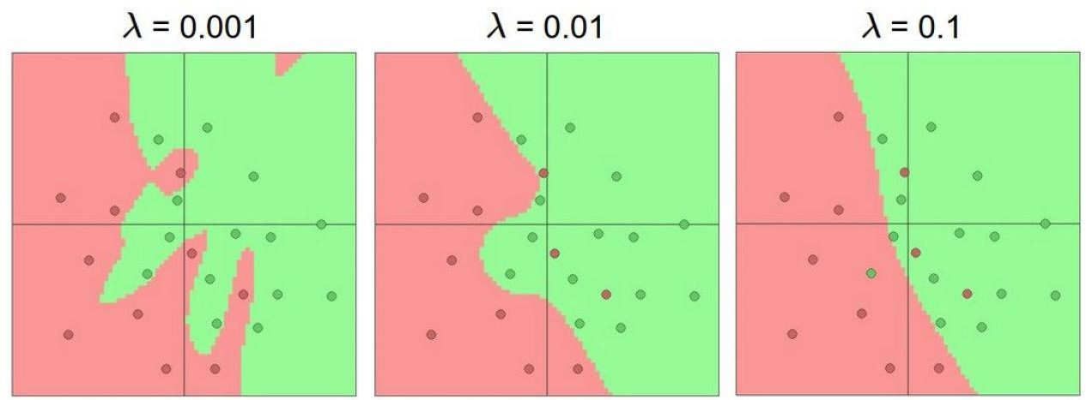
The role of regularization
The impact of punishment intensity on the outcome:
http://cs.stanford.edu/people/karpathy/convnetjs/demo/classify2d.html

Slide 32
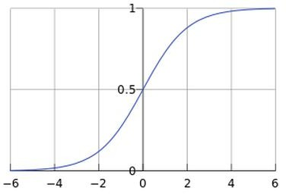

Softmax classifier
What we have now is an input score value, but wouldn't it be better if you gave me a probability value!
How to convert a score value into a probability value?-----Softmax classifier

Slide 33
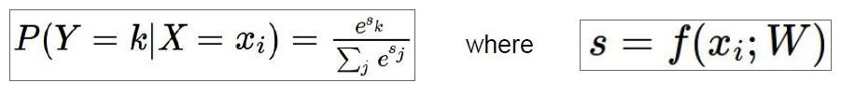

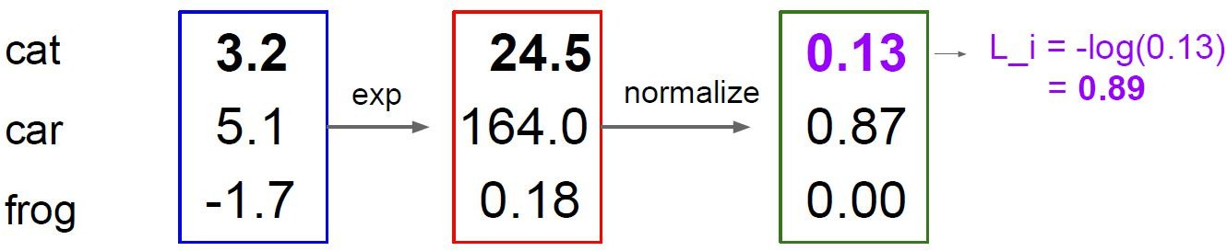
Softmax classifier
normalization:
Calculate loss value:
for example

Slide 34
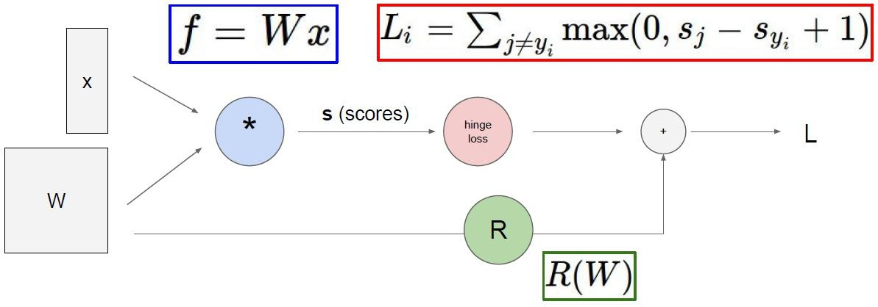
forward propagation
In the above learning, we have already learned how to calculate scores and loss functions. Now, how can we update and optimize our model based on this loss function to better recognize images.
This is left to backpropagation (gradient descent)

Slide 35
gradient descent
Introduction: After obtaining an objective function, how do we solve it?
Directly solving? (Not necessarily solvable, linear regression can be considered as a special case)
Conventional routine: The routine of machine learning is that I give the machine a bunch of data, and then tell it what learning method is right (objective function), and then let it do it in this direction
How to optimize: Don't become fat in one bite, we need to complete iterations step by step.(Every time you optimize a little bit, it accumulates to be a big achievement)

Slide 36

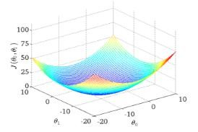
gradient descent
Objective function:
Find the lowest point of the valley, which is the endpoint of our objective function.
What parameters can make the objective function reach the extremum point
How many steps do you take down the mountain? (Update parameters)
1.Find the most suitable direction at present
2.Take such a small step
3.Update our parameters according to direction and pace

Slide 37




gradient descent
Objective function:
Batch gradient descent:
(Easy to obtain the optimal solution, but slow due to considering all samples each time)
Random gradient descent:
(Find a sample every time, the iteration speed is fast, but not necessarily in the direction of convergence every time)
Small batch gradient descent method:
(Choose a small portion of data to calculate each update, practical!)

Slide 38
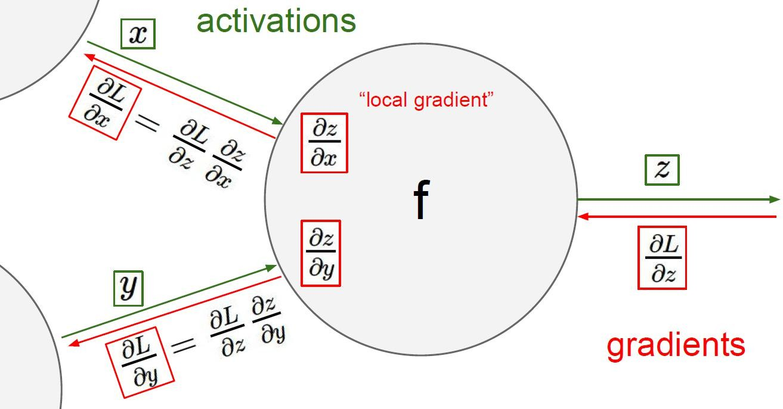
gradient descent
Chain rule:
The gradient
is transmitted
step by step

Slide 39
Overall architecture
brief summary
ConvnetJS demo: toy 2d classification with 2-layer neural network:
http://cs.stanford.edu/people/karpathy/convnetjs/demo/classify2d.html

Slide 40

Overall architecture
brief summary
the basic mechanism:
Continue stacking one layer:
The power of neural networks lies in fitting complex data with more parameters
(How many parameters are there? Even a million level is considered pediatric, but is more parameters better?)

Slide 41
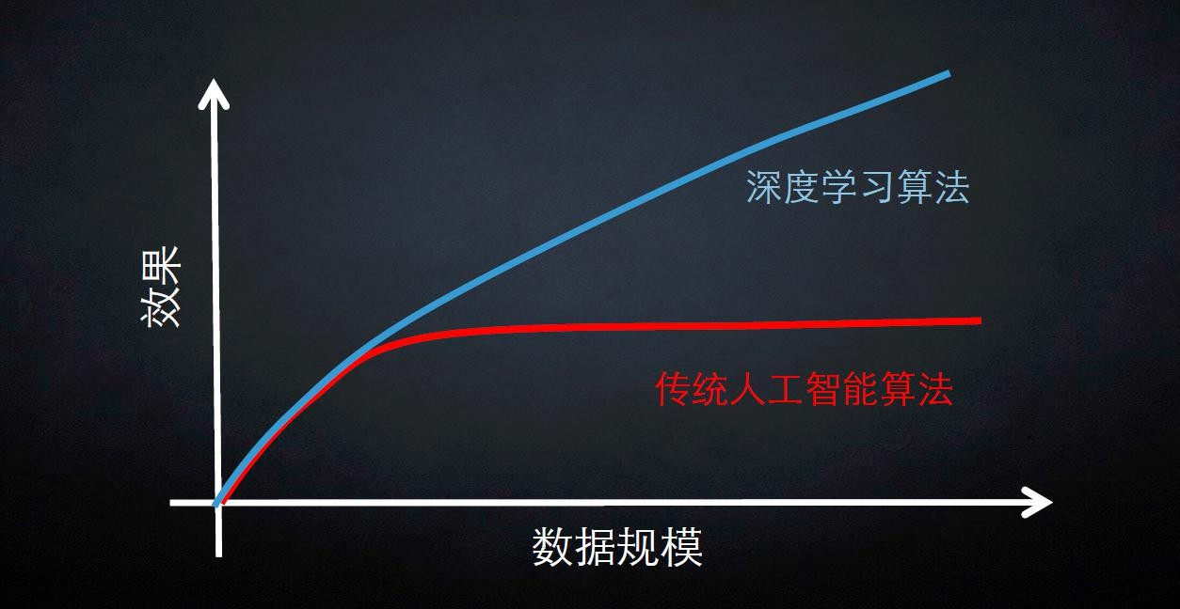
CDA LEVEL Ⅰ案例试听

Slide 42
03
Applications of Deep Learning

Slide 43
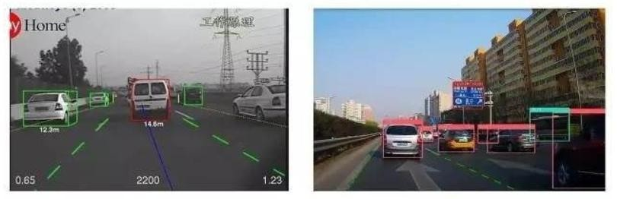
Applications: Self-driving cars recognizing traffic lights and pedestrians; Technology: CNN (Convolutional Neural Network) identifies edges, shapes, and semantic objects from pixels through multi-layer feature extraction.
Applications of Deep Learning

Slide 44
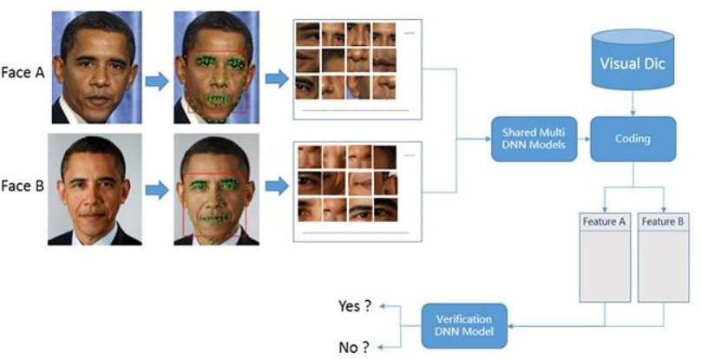
For example, a face recognition system extracts facial features through deep learning, is trained on these features, and ultimately enables the identification of human faces.
Applications of Deep Learning

Slide 45
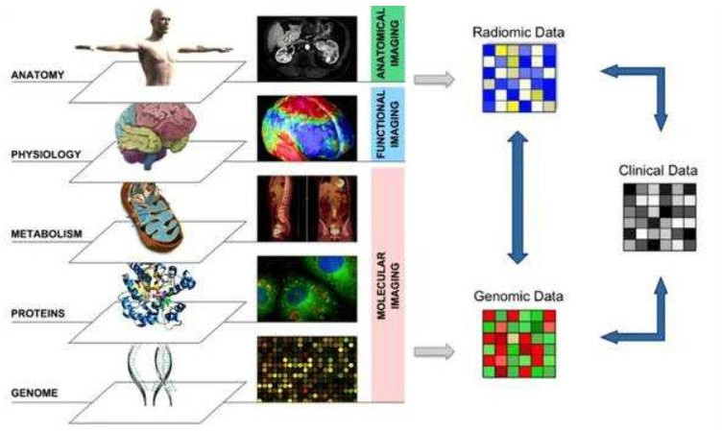
Applications: Detecting pneumonia and lung cancer in chest CT scans; predicting patient deterioration risk based on electronic health records (EHR).distinguishing benign/malignant tumors in medical imaging.
Applications of Deep Learning
Technology:
CNNs analyze medical images;
LSTMs process time-series patient record data.

Slide 46
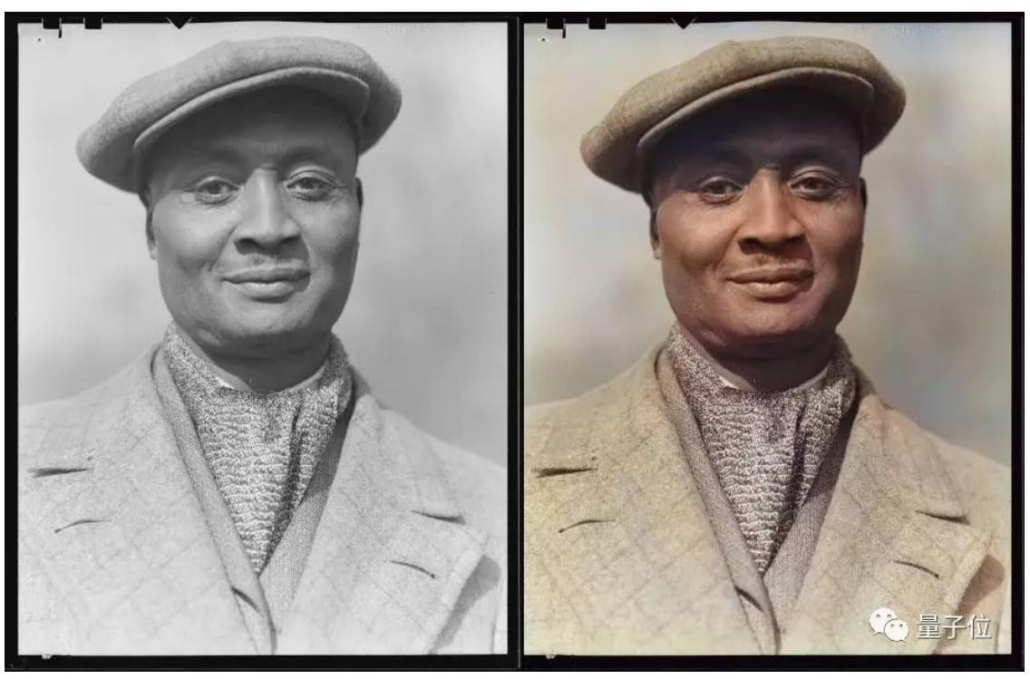
Applications: AI painting (e.g., Stable Diffusion), old photo restoration, super-resolution reconstruction.
Applications of Deep Learning
Technology: GANs (Generative Adversarial Networks) generate realistic images through competition between a generator and a discriminator.

Slide 47
THANK YOU
汇报人:
时间:2025.01.01

